Slide 1

Sprocket Central Pty Ltd
Data analytics approach
By Brian Mtsweni

Slide 2
Agenda
Introduction
Data Exploration
Model Development
Interpretation

Slide 3
Introduction
Identify and Recommend The Top 1000 Customers To Target From Datasets
Outline of the problem
Contents of Data Analysis
New and Old Customer Distribution
Bike-related purchases over the last 3 years by gender
Job Industry distribution of our customers
Wealth segment by age category
Number of cars owned and not owned by state
RFM analysis and customer classification
Sprocket Central Specializes in high-quality bikes and cycling accessories.
Their marketing team is looking to boost business sales by analyzing provided datasets.
Using the 3 datasets provided the aim is to analyze and recommend 1000 customers that sprocket central should target to drive higher value of the company

Slide 4
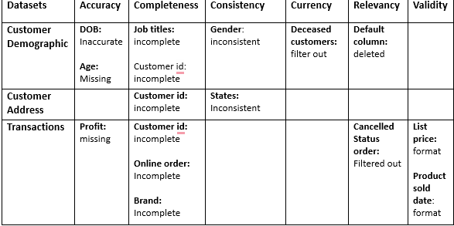
Data Exploration
Data Quality Assessment
Key issues for Data Quality assessment
Accuracy: Correct Values
Completeness: Data Field with values
Consistency: Values Free from contradiction
Currency: Values up to date
Relevancy: Data items with value meta-data
Validity: Data Containing Allowable Values
Uniqueness: Records that are duplicated
An in-depth analysis has been sent via email
Place any supporting images, graphs, data or extra text here.

Slide 5
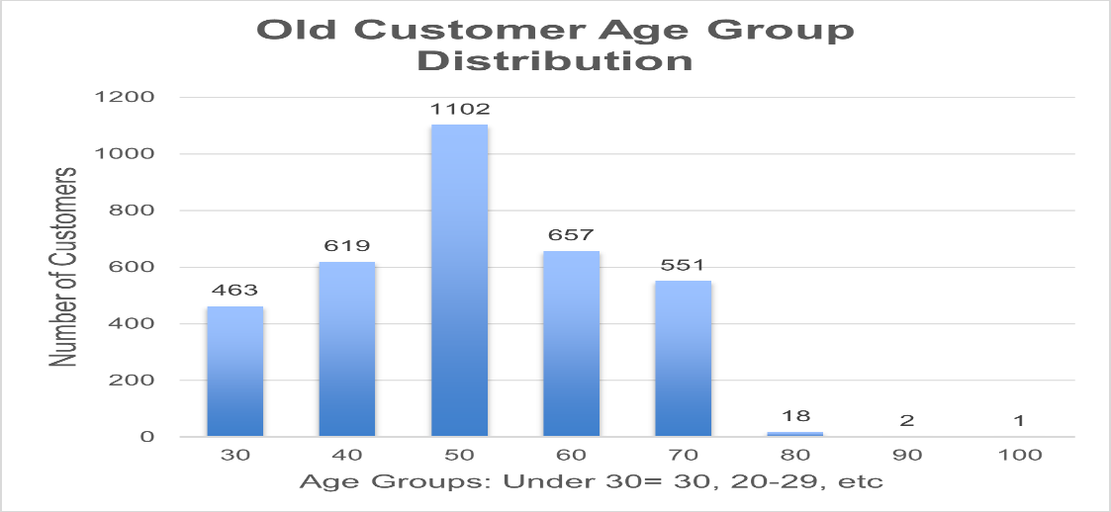
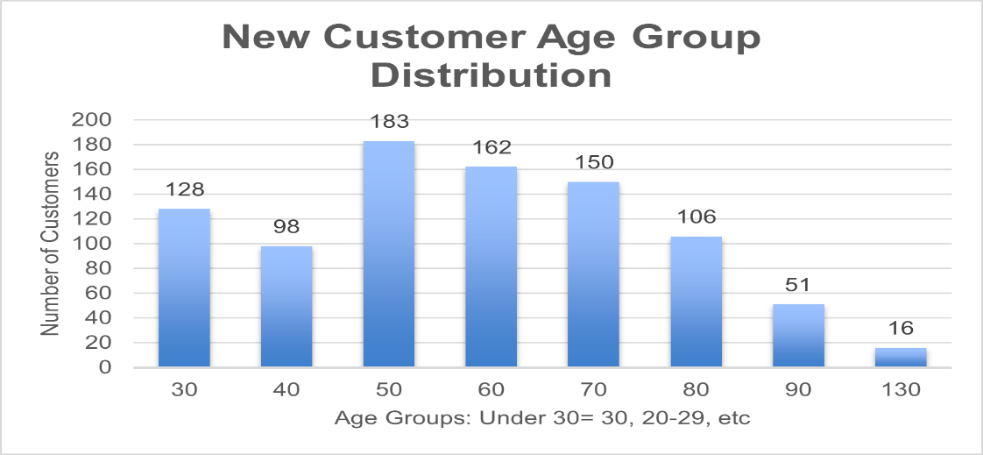
Data Exploration
New and Old Customer Distributions
Most Customers are aged between 40-49 in both ‘Old’ and ‘New.’
The lowest age groups are under 40 and 80+ for the ‘New’ customer list and for the ’ Old’ customer lists it’s under 30 and 80+.
The ‘New’ customer list suggests that age groups 20-29 and 40-69 are most populated.
The ‘old’ customer list suggests 30-69.
There is a steep drop of customers in the 30-39 age group in ‘New.’

Slide 6
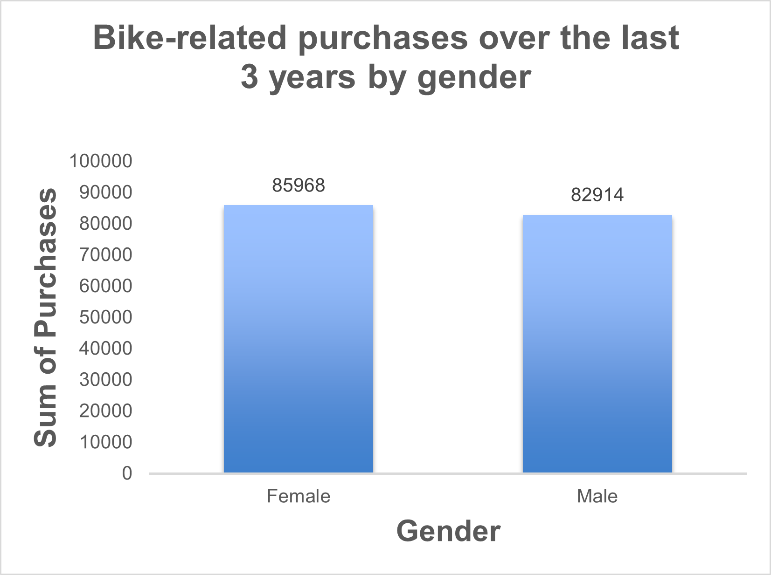
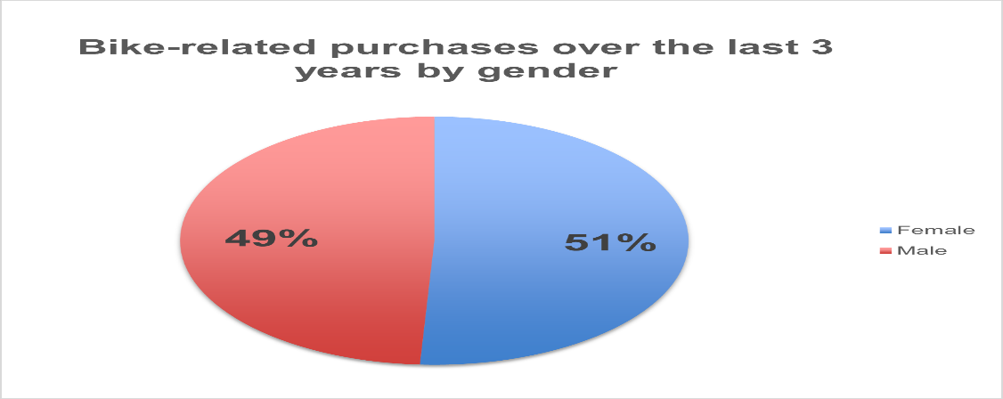
Data Exploration
Bike-related purchases over the last 3 years by gender
Over the last three years 51% of bike-related purchases were made by females to about 49% of purchases made by males.
Numerically, Females purchase almost 3000 more than males
Females make up the majority of bike-related sales

Slide 7
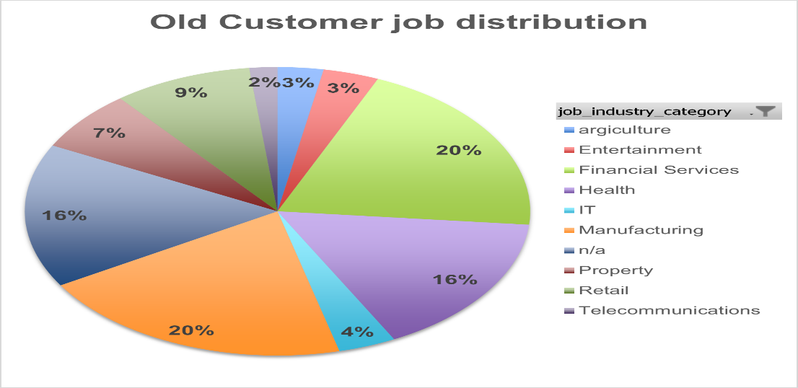
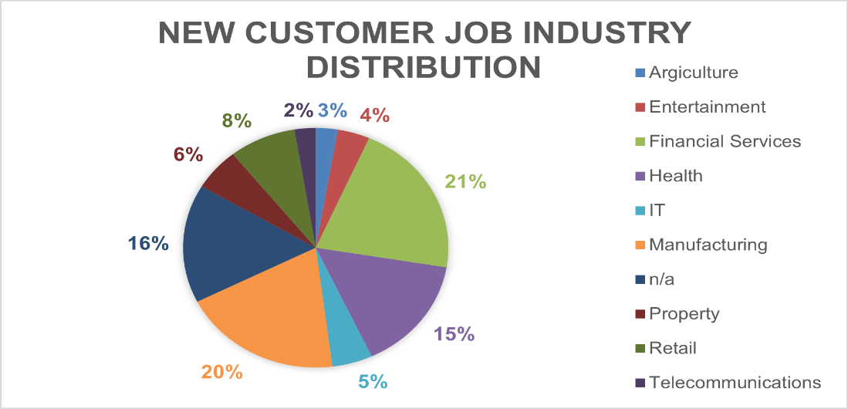
Data Exploration
Job Industry Distribution
Manufacturing and Financial Services industries have 20% and 21% respectively of our new customers.
For our old customers Manufacturing and financial services industries have 20% each.
The smallest numbers of customers both in the ‘old’ and ‘new’ are from the Agriculture and Telecommunications industries.

Slide 8
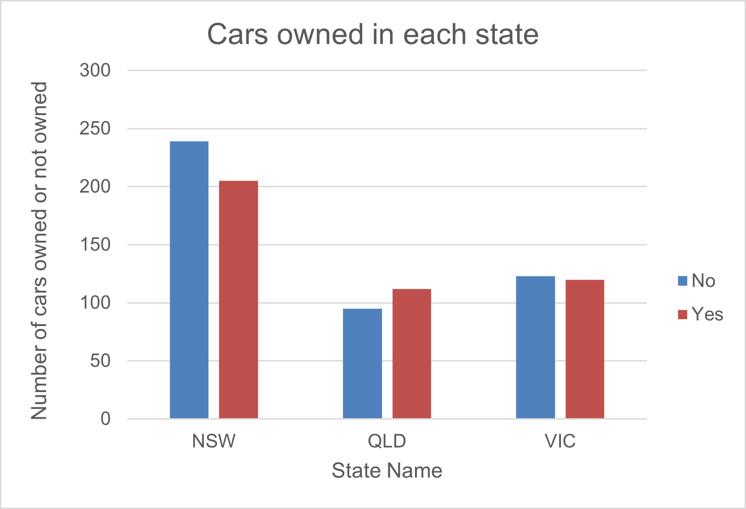
Data Exploration
Number Of cars owned and cars not owned by state
NSW largest number of people who do not own cars. NSW also has the higher number of people from the data collected
VIC is split evenly, but both numbers are lower than that of NSW.
QLD has more people that own cars than that don’t.

Slide 9
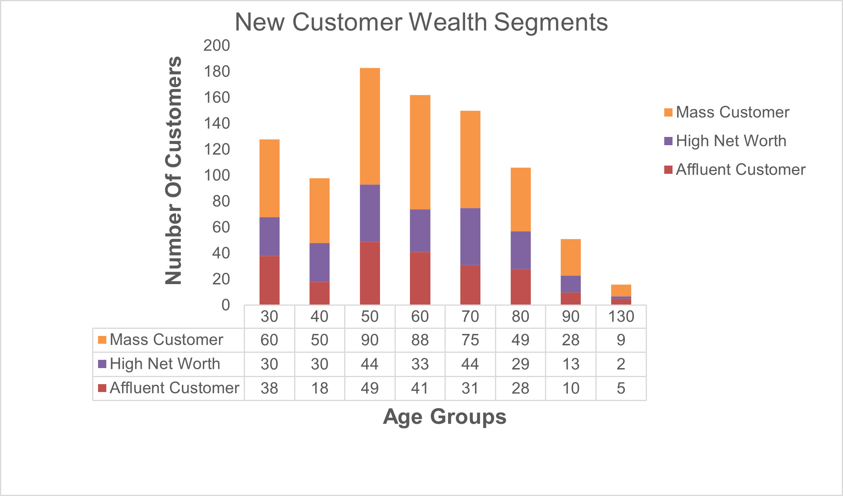
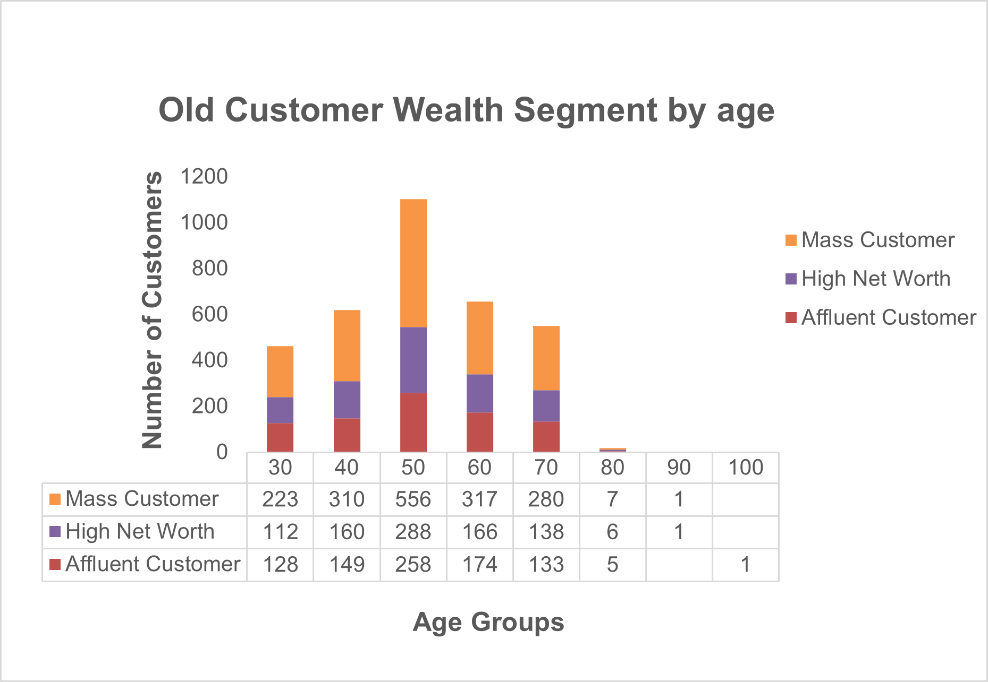
Data Exploration
Wealth Segment by age category
In all age groups the largest number of customers are ‘Mass Customers’
Second Highest is ‘High Net Worth’
The ‘Affluent Customer’ can outperform ‘Mass Customer’ in age group 40-49

Slide 10
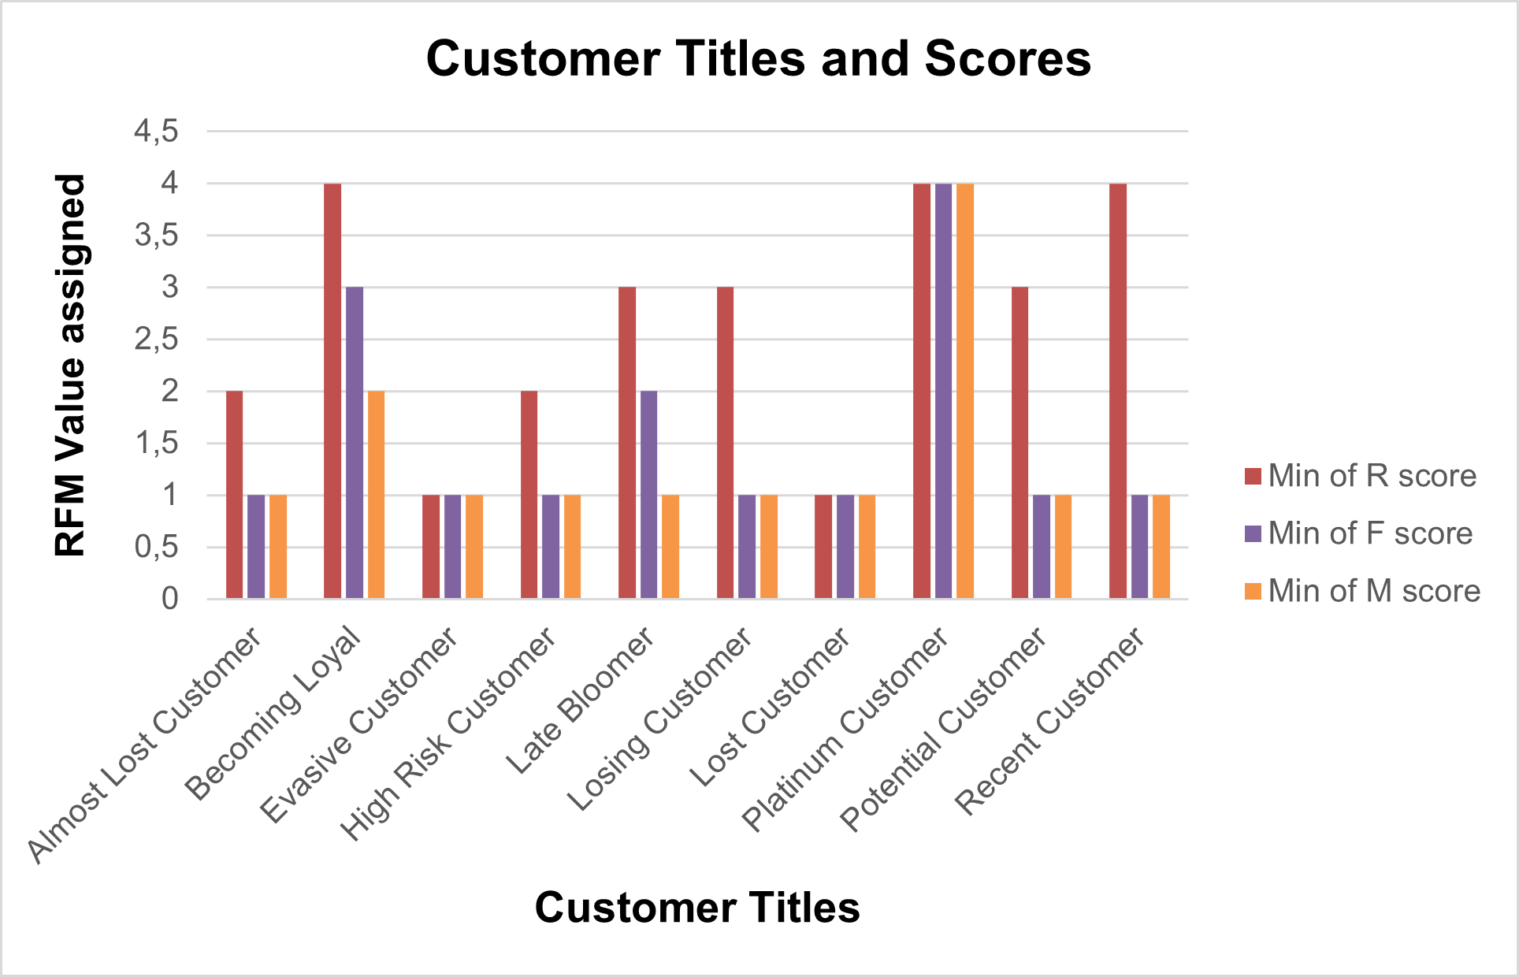
Model Development
RFM Analysis and Customer Classification.
RFM analysis is used to determine which customers a business should target to increase revenue and value
The RFM(Recency, Frequency, and Monetary) model shows customers who have displayed high levels of engagement with the business in the three categories mentioned.
Place any supporting images, graphs, data or extra text here.

Slide 11
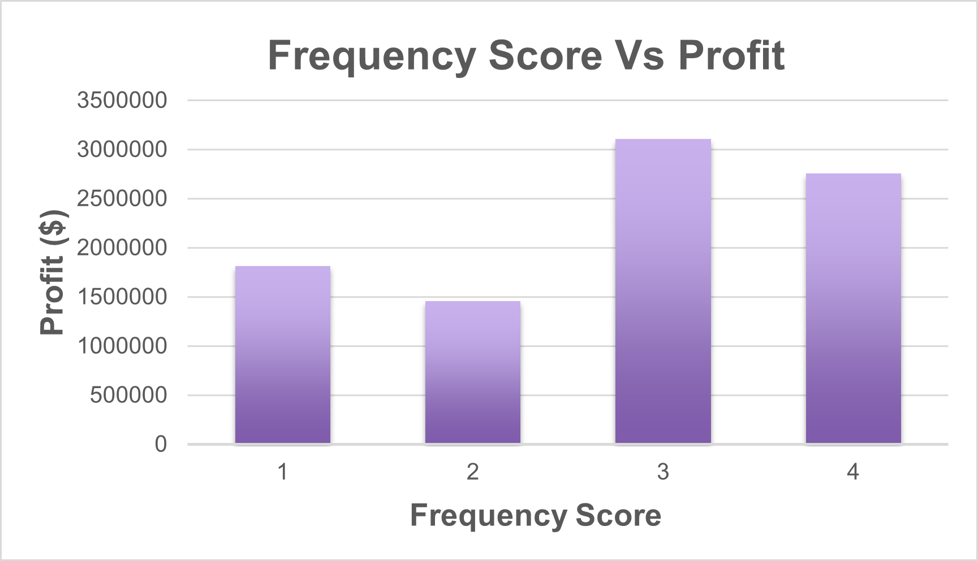
Model development
Scatter-plot based off RFM analysis
The chart shows that customers who purchased more recently Frequently generate more Profit.
Customers who have a Frequency Score of 3 seem to generate more profit than those with other scores.
Those with Frequency Score of 4 come in second.

Slide 12
Model Development
Customer Titles Definitions list with RFM values assigned
Rank | Customer Title | Description | RFM Value
1 | PLATINUM CUSTOMER | Most recent buy, buys often, most spent | 444
2 | Very Loyal | Most recent, buys often, spends large amount of money | 433
3 | Becoming Loyal | Relatively recent, bought more than once, spends large amount of money | 421
4 | Recent Customer | Bought recently, not very often, average money spent | 344
5 | Potential Customer | Bought recently, never bought before, spent small money | 323
6 | Late Bloomer | No purchases recently, but RFM is higher than average | 311
7 | Losing Customer | Purchased a while ago, below average RFM value | 224
8 | High Risk Customer | Purchases was a long time ago, frequency is quite high, amount spent is high | 212
9 | Almost Lost Customer | Very low recency, low Frequency, but high amount spent | 124
10 | Evasive Customer | Very low recency, low frequency, small amount spent | 112
11 | Lost Customer | Very Low RFM | 111

Slide 13
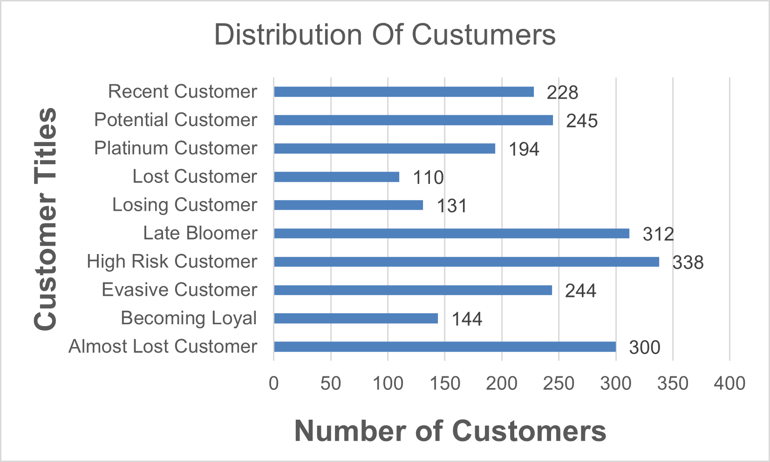
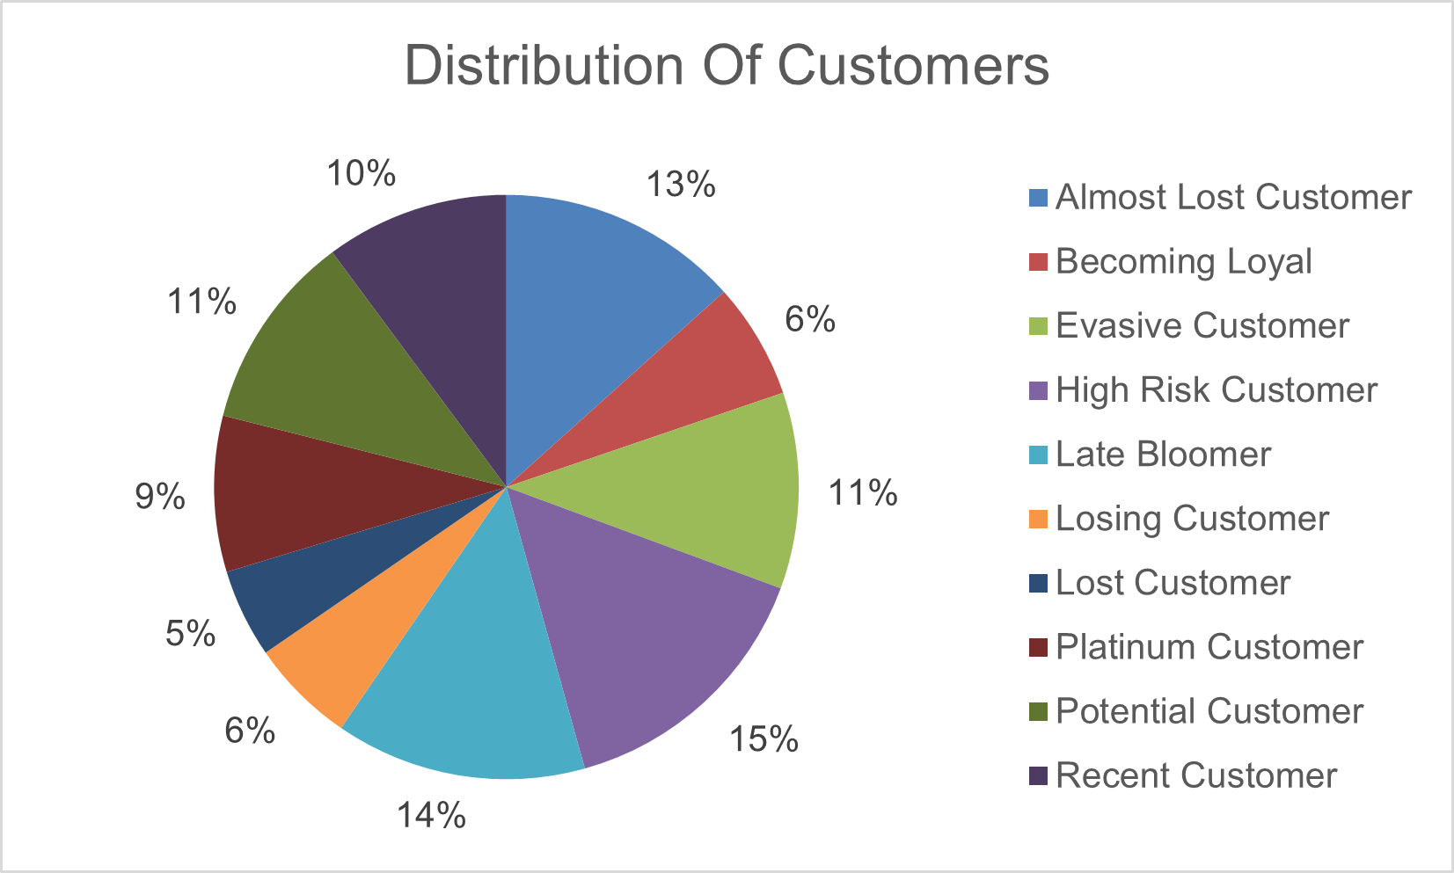
Model Development
Customer Title Distributions in Dataset

Slide 14
Interpretation
Summary Table of the Top 1000 Customers to Target
Rank | Customer Title | Description | Number Of Customers | Cummulative | Customer Selection
1 | PLATINUM CUSTOMER | Most recent buy, buys often, most spent | 194 | 194 | 194
2 | Very Loyal | Most recent, buys often, spends large amount of money | N/A | 194 | 0
3 | Becoming Loyal | Relatively recent, bought more than once, spends large amount of money | 144 | 338 | 144
4 | Recent Customer | Bought recently, not very often, average money spent | 228 | 566 | 228
5 | Potential Customer | Bought recently, never bought before, spent small money | 245 | 811 | 245
6 | Late Bloomer | No purchases recently, but RFM is higher than average | 312 | 1123 | 189
7 | Losing Customer | Purchased a while ago, below average RFM value | 131 | 1254 | 0
8 | High Risk Customer | Purchases was a long time ago, frequency is quite high, amount spent is high | 338 | 1592 | 0
9 | Almost Lost Customer | Very low recency, low Frequency, but high amount spent | 300 | 1892 | 0
10 | Evasive Customer | Very low recency, low frequency, small amount spent | 244 | 2136 | 0
11 | Lost Customer | Very Low RFM | 110 | 2246 | 0

Slide 15
Interpretation
Customer Target
Rank | Customer Title | Description | Number Of Customers | Cumulative | Customer Selection
1 | PLATINUM CUSTOMER | Most recent buy, buys often, most spent | 194 | 194 | 194
3 | Becoming Loyal | Relatively recent, bought more than once, spends large amount of money | 144 | 338 | 144
4 | Recent Customer | Bought recently, not very often, average money spent | 228 | 566 | 228
5 | Potential Customer | Bought recently, never bought before, spent small money | 245 | 811 | 245
6 | Late Bloomer | No purchases recently, but RFM is higher than average | 312 | 1123 | 189

